Slide 1
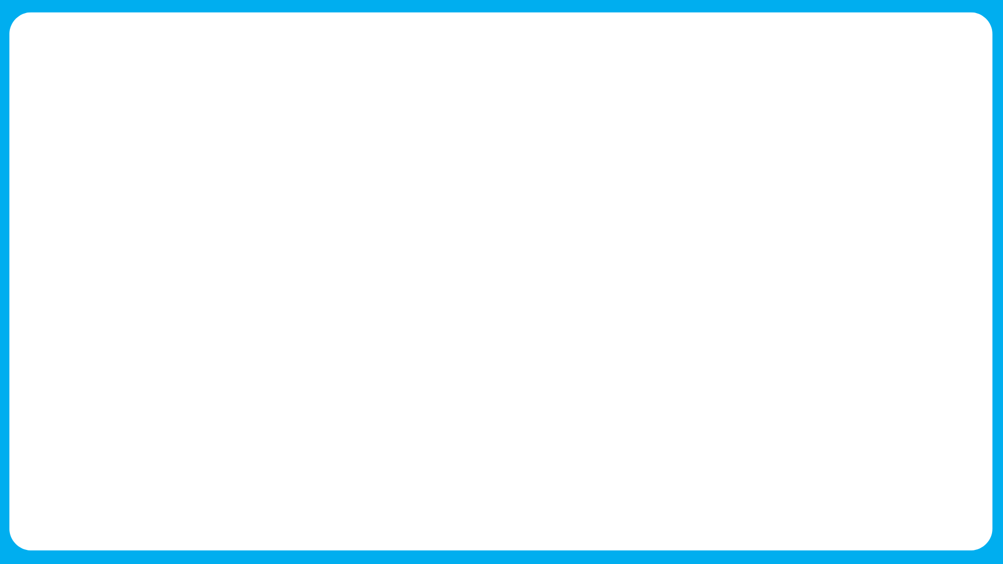

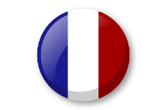

Knowledge organiser: The calendar and celebrations.
Noun Bank
lundi - Monday
mardi- Tuesday
mercredi - Wednesday
jeudi- Thursday
vendredi- Friday
samedi - Saturday
dimanche- Sunday
Noun bank
janvier- January
février- February
mars- March
avril- April
mai- May
juin- June
juillet- July
août- August
septembre – September
octobre – October
novembre – November
décembre - December
Grammar
When you ask a question in French you can turn a sentence into a question by raising the pitch of your voice at the end of the question. Practice reading these phrases!
Aujourd’hui, c’est lundi.. – Today is Monday.
Aujourd’hui, c’est lundi? – Is it Monday today?
Question and Answer Bank
C’est quand ton anniversaire? – When is your birthday?
C’est quel jour aujourd’hui?- What day is it today?
Grammar
When words are the same in two languages we call them cognates and when they look very similar we call them semi-cognates.
Fact Bank
Some of the French days of the week are named after the planets
e.g. mardi → Mars
Phonics
“di” (lundi, mardi, dimanche)
“er” (janvier, février)
“et” (juillet)
Fact Bank
Lots of the months in French look very similar to English spelling of the months.

