Slide 1



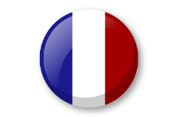
Knowledge organiser: Animals
Noun Bank
un chat - a cat
un chien - a dog
un poisson - a fish
un cheval - a horse
un lapin - a rabbit
un mouton - a sheep
un serpent - a snake
un oiseau - a bird
une vache - a cow
une souris - a mouse
Question and Answer Bank
J’ai .. – I have
Je vois… - I see
Mon animal préféré est …. - My favourite animal is….
Quel est ton animal préféré? – What is your favourite animal?
Phonics
“ch” (chat, chien, vache)
“oi” (poisson, oiseau)
“ou” (mouton, souris)
“on” (mouton, poisson)
Grammar
There are two words for “a”
in French.
These words are “un” and “une”.
Grammar
In French we add an ‘s’ at the end of the nouns to form the plural: chats, chiens, poisons.
Watch out for the exceptions : oiseaux, chevaux
Fact Bank
In different languages animals make different noises. In French, the noise a dog makes is “ouaf”.
The rooster is the national symbol of France as a nation .(le coq gaullois)

